Slide 1
HackerThings
Analysis & Recommendations
By Team 3
Michael, Valeria, Rakshanda, Sam, & Daniel

Slide 2
Fun Facts & Findings
Most Frequent Donor: 39df9399f5384334a42905bcf0acdcbf18035
Total Donations Made: 18,035
Total Amount Donated: $37,121.72
Largest Donor: 2144d56b1947ebb26a19e7f1d07c970a
Total Donations Made: 2,152
Total Amount Donated: $1,243,529.69
Highest Donation Year: 2017
Total Amount Donated in 2017: $72.8 M
Month with Most Donations are Made: December
Notes:
Daniel

Slide 3
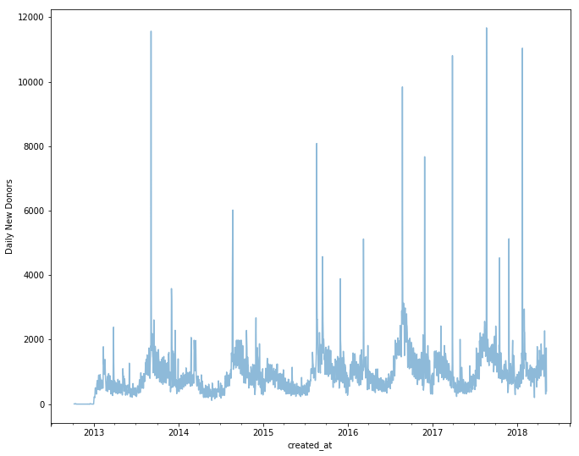
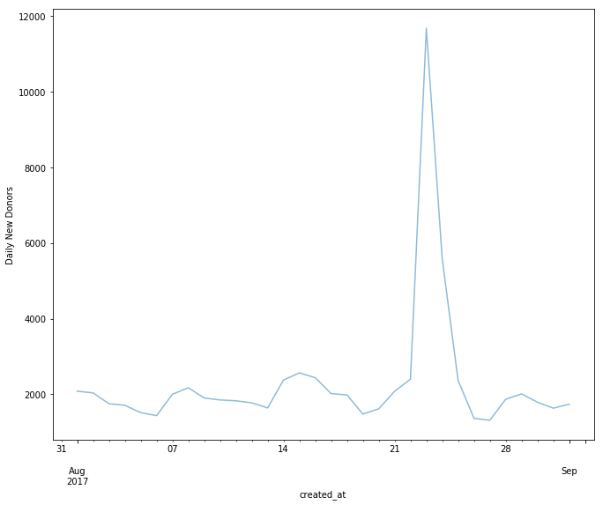
Acquisition Rate
Assumption: Acquisition rate is defined as the number of first-time donations for a given time period.
Count of First Time Donors by Date (Full)
Count of First Time Donors by Date (Aug ‘17)
Enhance!
Observation: Nearly 12,000 new donors on August 23.
Follow-up ideas: investigate possible causes of spike; compare 12,000 with past spikes to help determine what worked better this time around.
Notes:
Michael

Slide 4
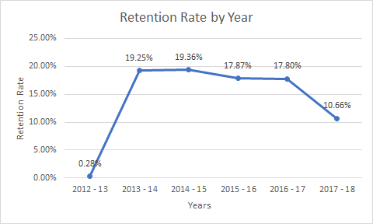
Retention Rate
Suggestions for Improvement:
Review what was used in 2014-15
Give donors a voice (ideas, concerns, etc.)
Membership Program
Share Success Stories (constant reminders)
Fundraising Effectiveness Project¹ reports the average retention rate is 45%
Notes:
1 http://afpfep.org/wp-content/uploads/2018/04/2018-Fundraising-Effectiveness-Survey-Report.pdf based on information compiled by Bloomerang, DonorPerfect, Neon, Blackbaud, and
Daniel

Slide 5
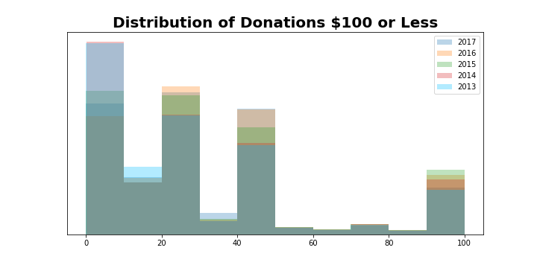
Trends in Donation Habits
Notes:
Sam

Slide 6
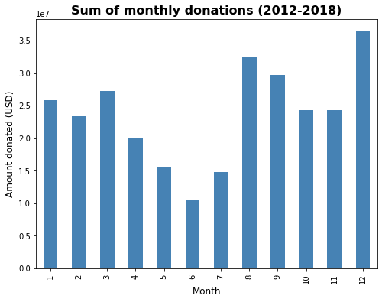
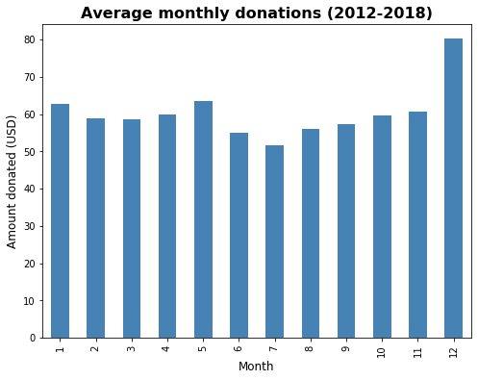
Trends in Donation Habits
Notes:
Val

Slide 7
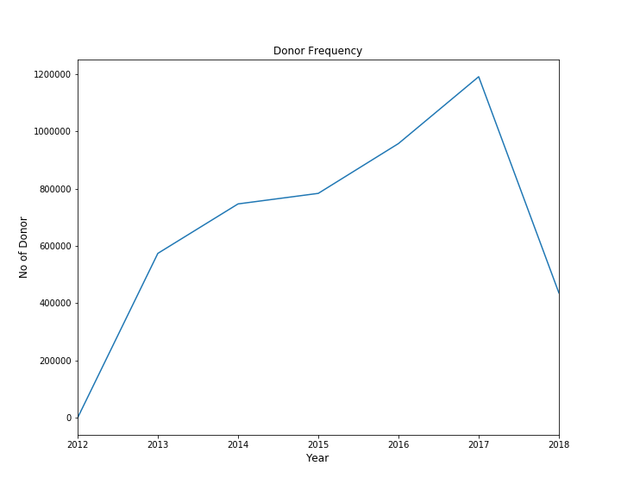
Number of Donations
(2012 & 2018 did not have complete data)
Notes:
Rakshanda

Slide 8
Top 5 Single Donation Amounts
Donor ID | Amount | Date
8f70fc7370842e0709cd9af3d29b4b0b | $60,000.00 | 2013-04-25
b802c941986ae91fdf0beabb1e35e1a9 | $31,856.60 | 2017-03-02
46bef03dfe2742079289cd67a26a8d27 | $26,369.03 | 2013-07-26
b51a1b79ce091021e909fde33c5e5810 | $25,000.00 | 2017-11-15
5aae045f65ce626b6c56b1d1f974fbf1 | $21,299.95 | 2013-08-22
Notes:
Rakshanda

Slide 9
Futures Ideas
Incorporate predictive algorithm(s) to estimate the likelihood that a donor will continue donating based on past behavior. Could give the non-profit an idea of what they can project for future donations.
Create membership program/donor subscriptions service to help retain donations
Link other time-series datasets and see if we can find any correlations between external events and amounts donated. Can help the non-profit know when they should swarm a particular opportunity to drive donation amounts.
Demographics of Donors (ages, locations, income brackets, etc.)
Local sports team win/loss
Stock market average up or down
Social media sentiment analysis
Top billboard hit song
Lunar phase

Slide 10
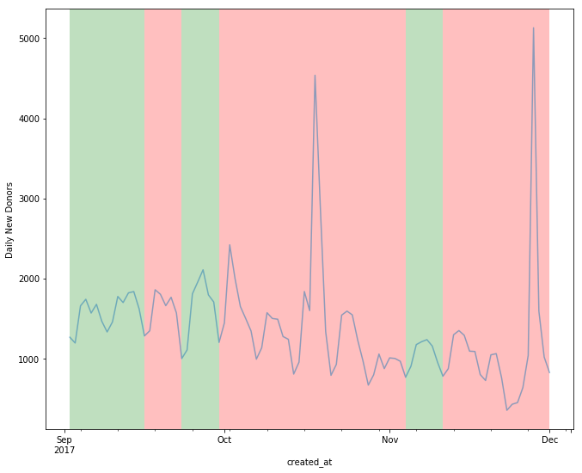


Do the Vols Matter?
Green = W
Red = L
Notes:
Michael

